Slide 1
Exploring extreme heat
Satellite imagery and raster analysis in R

Slide 2
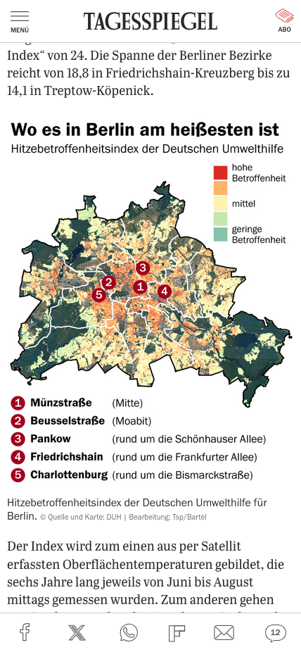

Slide 3
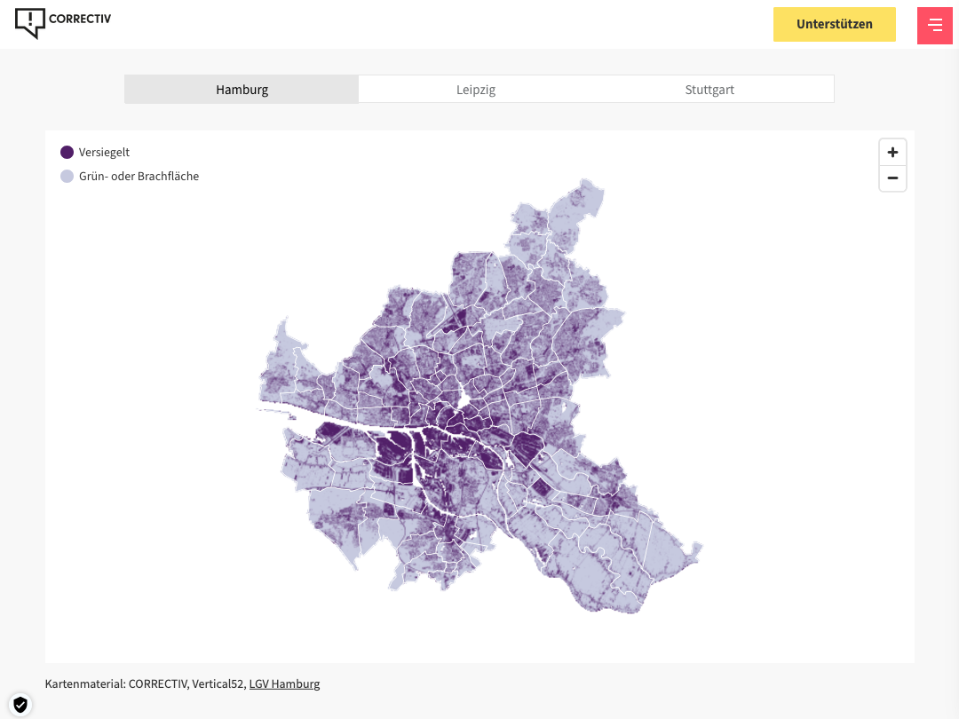

Slide 4
How is heat measured?
Beyond the weather report

Slide 5

How is heat measured?
Beyond the weather report
Surface air temperature
~ 2m off the ground, used in weather reports, closer to what we feel
Land surface temperature (LST)
Strongly influenced by material, can be hotter/cooler than air temperature due to thermal mass
Image credits: Cornvinus University of Budapest

Slide 6
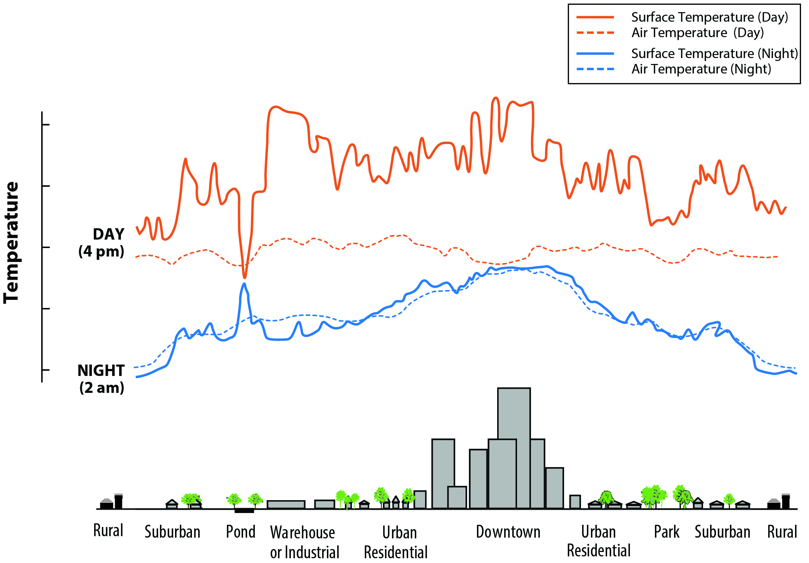
The urban heat island effect
Beyond the weather report
Materials such as brick, concrete, asphalt and pavement have higher thermal mass.
This means they absorb and store heat throughout the day.
Image credits: EPA

Slide 7
Which metric is better to use?
Beyond the weather report
Surface air temperature
Reflects „felt“ temperature
Directly measured via weather stations, sensors and other on-site instruments
Measurements are continous throughout the day, regardless of weather conditions
May not be representative of the surrounding geographic area
Sensors may not be consistent (height, direction, etc.)
Land surface temperature
Measured via satellites, aircrafts or ground-based thermal sensing
Better geographic coverage
Shows the direct impact of of sealing in urban areas
Clouds, trees and tall buildings can limit usability
Temporal and spatial resolution often dependent on third party providers, higher resolution data can be costly

Slide 8
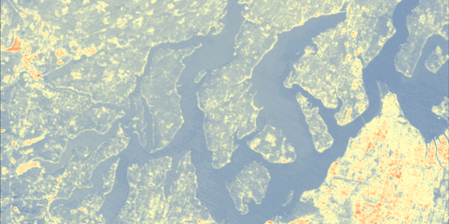
How to access free, high quality satellite imagery
02
Getting started with Landsat

Slide 9
What is the Landsat satellite program?
Getting started with Landsat
Series of Earth-observing satellite missions jointly managed by NASA and the U.S. Geological Survey.
Optimized for tracking land use and changes due to climate change, urbanization, droughts, wildfires, and more.
World’s longest continuous archive of satellite imagery: 1972 to present
It’s also free.

Slide 10
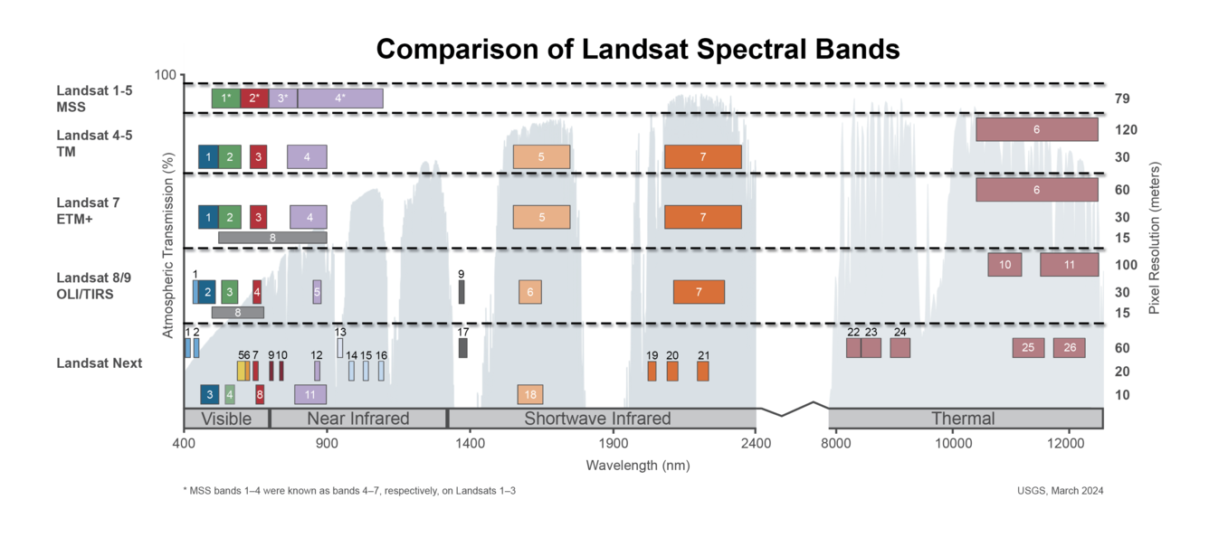
How do satellites measure surface temperature?
Getting started with Landsat
Satellites can record a large range of waves in the electromagnetic spectrum…

Slide 11
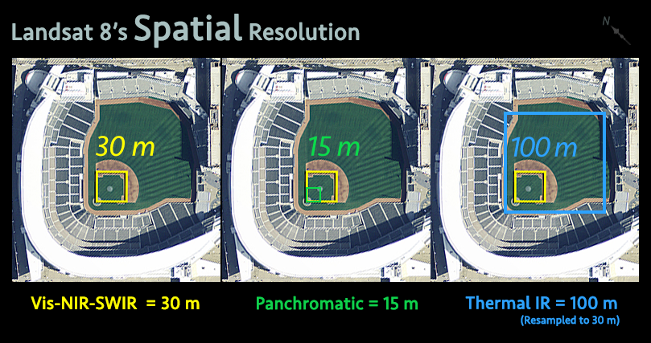
Understanding spatial and temporal resolution
Getting started with Landsat
Spatial resolution
How „clear“ an image is
Landsat: 15 - 100 meters
Temporal resolution
How often an image is taken
Landsat: Every 16 days
Image credits: USGS

Slide 12
Landsat‘s data structure
Getting started with Landsat
Collection 1
Legacy processing with lower accuracy; retired 2022
Collection 2 Level-1
Improved accuracy, raw satellite measurements
Collection 2 Level-2
Analysis-ready, corrected for atmospheric effects, but due to use of auxiliary data slightly more limited coverage

Slide 13
What‘s a (Geo)TIFF file?
Getting started with Landsat
Tagged Image File Format (TIFF)
Contains raster graphic images. Uses lossless compression, which is good for large file sizes and preserving high-quality data.
GeoTIFF
Combines a TIFF image with embedded geographic metadata.
The embedded metadata specifies the image's coordinate reference system (CRS), map projection, and how the image data corresponds to real-world coordinates.

Slide 14
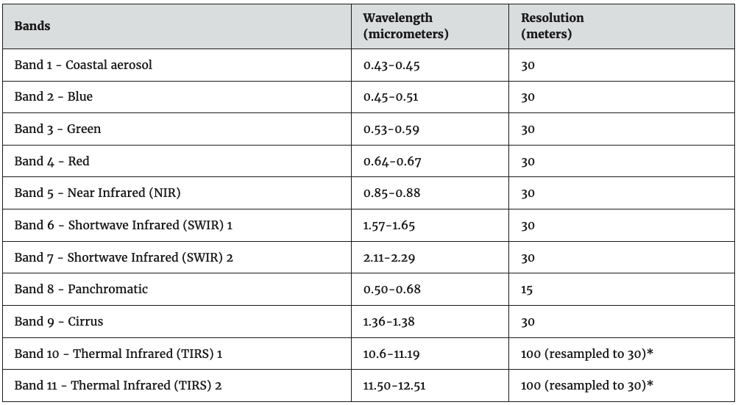
Landsat: What you get
Getting started with Landsat
One TIFF file per band (red/green/blue/near infrared/thermal infrared/surface temperature/etc.)
Plus: Quality assessment bands

Slide 15
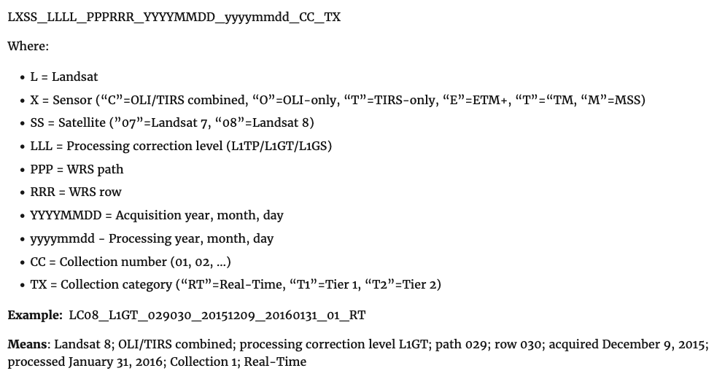
Landsat file naming conventions
Getting started with Landsat

Slide 16
Let‘s get started! (TK QR code/link)

Slide 17
Thank you!
Max Donheiser
Tagesspiegel Innovation Lab
Jonathan Stoneman
Arena for Journalism in Europe
GitHub Repo
maxdonheiser/dh25-landsat-R

